Slide 1
Data Analytics and Power BI
Presented by
A.karthika

Slide 2
What is Data Analyst ?
Data Analytics is the process of examining data sets to draw conclusions about the
Information they contain.
It involves the use of specialized systems and software to collect, process and analyze
large volumes of data.

Slide 3
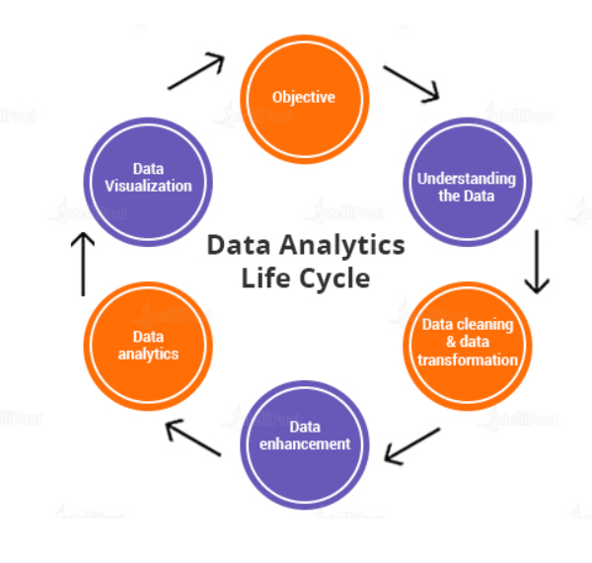
Life cycle of Data Analytics

Slide 4
Types of Data Analytics
Descriptive Analytics
Predictive Analytics
Prescriptive Analytics

Slide 5
Descriptive Analytics
It aims to help uncover valuable insight from the data being analyzed.
It has two types:
Measures of central tendency
Mean
Median
Mode
Measures of dispersion
Range
Variance
Standard Deviation

Slide 6
Predictive Analytics
It helps forecast behavior people and markets.
Several of the models that can be used.
Forecasting
Simulation
Regression
Classification
Clustering

Slide 7
Prescriptive Analytics
Decisions can be formulated from Descriptive and Predictive Analytics.
Variety of Techniques:
Linear Programming
Integer Programming
Mixed Integer Programming
Non-linear Programming

Slide 8
Advantages
Improved Decision-making
Increased Efficiency and Productivity
Improved Risk Management
Enhanced Customer Experience

Slide 9
Power BI
Power BI is a business Intelligence tool developed by Microsoft. It is a Data visualization
and Business Intelligence tool which helps to convert data from different data sources into
Interactive dashboards and BI reports.
Need for Power BI
Power BI allows you to access the data and create dashboards and reports at one go with
just few clicks. This helps in gaining new customer and managing the existing ones in the
smoothest manner.

Slide 10
Training Resources data files
1.Data File:dataset > link
2. Explore the data files
3.Connecting to the Data sources
Open Power BI to local system
Select data on the left hand menu bar
Go to the Power Bi environment
Select text/csv from the list and connect
Import the data as it is, load into Power Bi Desktop

Slide 11
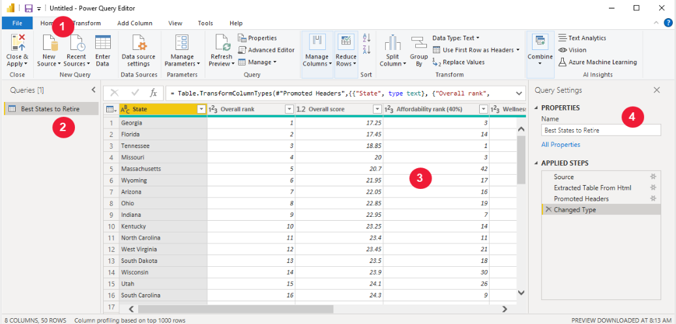
Interface of Query Editor

Slide 12
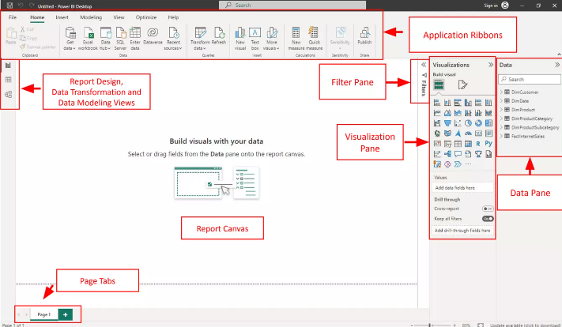
Power BI Desktop Application Interface

Slide 13
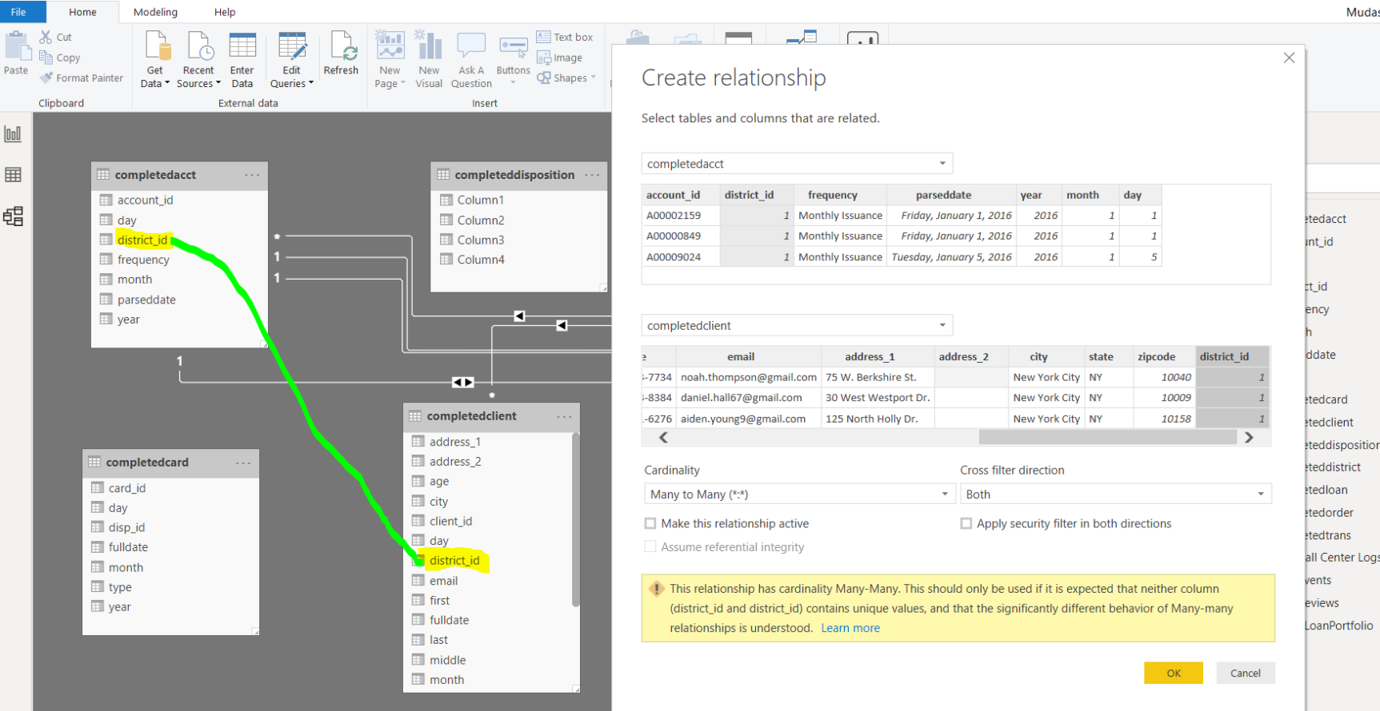
Creating Relationships

Slide 14
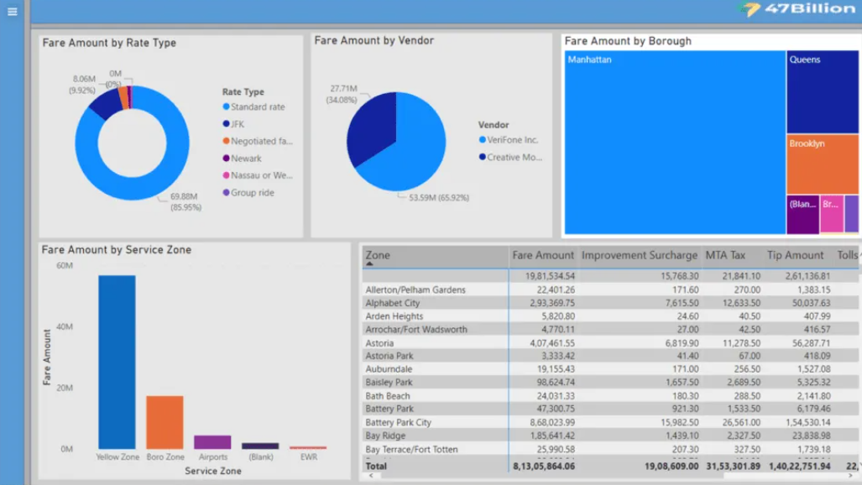
Data Visualization

Slide 15
Advantages
Simple to use
No Memory and Speed constraints
Secure Report Publishing
Continuous Updates

Slide 16
THANK YOU

